Slide 1
Discussion 12
Final Review
Jason Zhou | Section 136
CS61A Spring 2019

Slide 2
Announcements
Today: Lab 13 Due
RRR Week: Topical Review Sessions
Tail Calls and Tail Recursion
Iterators & Generators
Recursion (no tree recursion)
Tree Recursion
Environment Diagrams
Linked Lists
Trees
SQL
OOP
Streams
Orders of Growth
Mutable Functions & Objects
Scheme (material besides macros/tail recursion)
Macros
Final: 5/14, 11:30 - 2:30 PM

Slide 3
Agenda
Final Exam Format
Discussion Worksheet
Last Words

Slide 4
Example Final Exam Format
Final: 6 - 8 Questions, 3 Hours, cumulative, clobbering
WWPD
Classes/Inheritance
Environment Diagram
List Mutation, Mutable Functions
SQL Coding
Scheme Coding
Macros
Streams
Tail Recursive Function
Tree Recursion/Recursion
Runtime Analysis/OOG
Linked Lists
ADT Tree vs. Class Tree
Generators/Iterators

Slide 5
Final Practice

Slide 6
5.2 Pythontutor Links
5.2 Attempt 1 Walkthrough
5.2 Attempt 2 Walkthrough

Slide 7
3 Last Thoughts

Slide 8
Last Thoughts 1
CS 61A: Exams are tricky
Problems dealing with edge-cases, exceptions
Purposefully obfuscated names
Forced to fit your thinking to pre-made skeleton
Heavy workload, fast pace
Multiple programming languages can feel rushed
Odd choice of topics for an introductory CS class
Scheme, Macros
Not entirely applicable/practical
-----------------------------------------------------------------------------------
But: incredibly solid on foundations (unfortunately includes edge cases), attention to detail
Goal: Learned the fundamentals of problem solving in computer science
Through vast exposure to different topics
Approach to tackling problems:
Iterative thinking: how to solve a problem by building up little pieces
Recursive thinking: how to solve a problem by reducing it to a smaller version of itself
Not how to program or write code in Python

Slide 9
Last Thoughts 2
If you continue:
CS 61A: Structure and Interpretation of Computer Programs (SICP)
CS 61B: Data Structures
Exams a little less “tricky”
Heavy workload
Real-world applicable, practical algorithms
Ex. how to efficiently store data (using a tree class? Different types of trees?)
Highly essential & useful for internships/jobs
60% of SWE interviews don’t go beyond 61B level knowledge
Heavily, rigorously builds upon CS 61A concepts
Pick up at OOP once more
If you do not continue:
You now know how to program & what exactly is computer science
Cannot overstate the importance and ubiquity of modern day computing
Always useful and brave to have taken Cal’s “infamous” CS 61A
Challenging for prospective CS majors already
Can understand CS memes on UCBMFET

Slide 10
Last Thoughts 3
Become involved!
Apply for course staff
Student org: Computer Science Mentors (CSM)
Teach a 1hr/week section of 3-5 people
Pedagogy classes: CS 370, CS 375
Spring 2017: CS 61A Student
Summer 2017: CS 61A Academic Intern/Lab Assistant
Fall 2017, Spring 2018: CS 61A Tutor
Fall 2018, Spring 2019: CS 61A TA
Fall 2019, Spring 2020: CS 161 (?) CS 61A (?)
Thanks for the good times!
Your feedback is incredibly valuable
Sat through many hours of Jason
- links.cs61a.org/jasonz-feedback
- Official Department Course Evaluations

Slide 11
Good luck!
Contact:
jasonxzhou.com
(Slides always available)
jasonzhou@berkeley.edu
Attendance: links.cs61a.org/jasonz-attendance

Slide 13
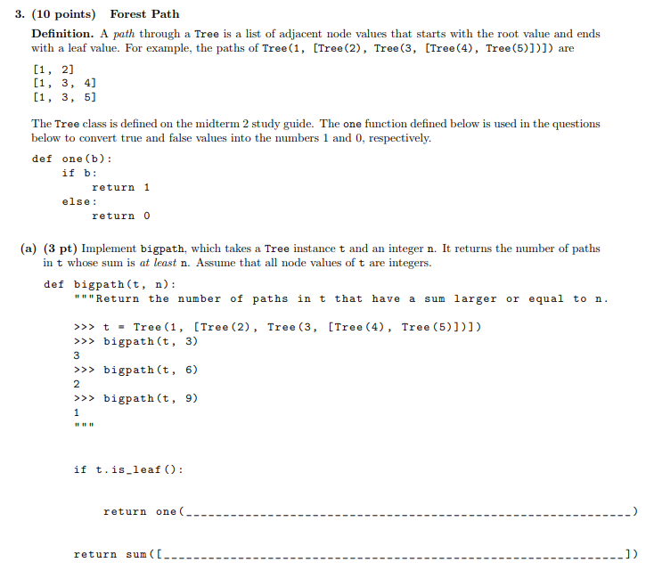

Slide 14
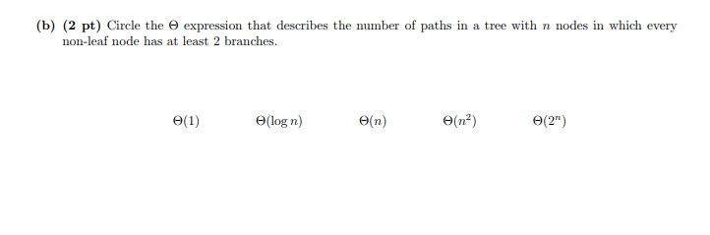

Slide 15
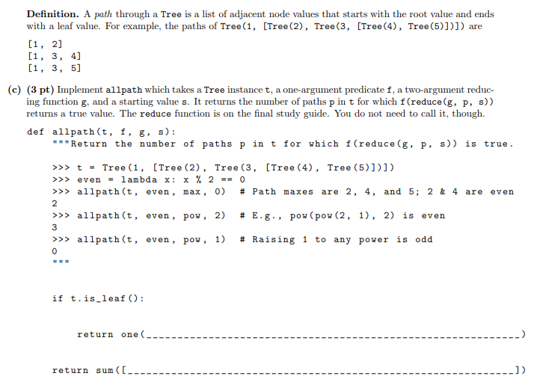

Slide 16
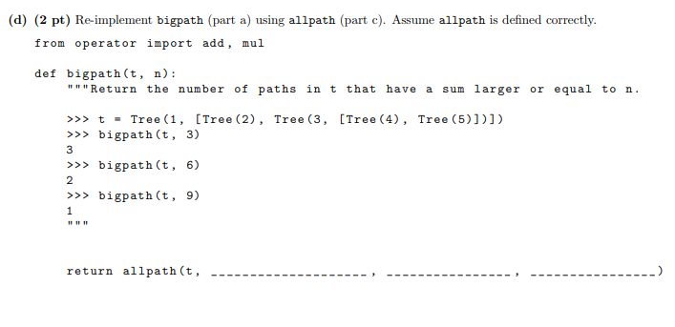

Slide 17
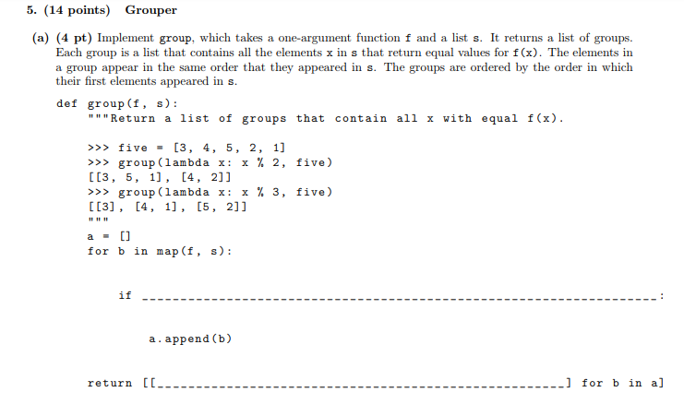

Slide 18
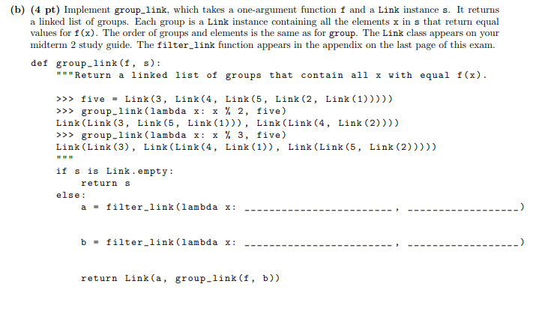

Slide 19
